Slide 1
Refworld.org
UNHCR’s Global Law and Policy Database
IARMJ conference, 15th November 2022, Arusha
Richard Grindell, UNHCR Regional Bureau for the East, Horn of Africa and the Great Lakes, Nairobi

Slide 2
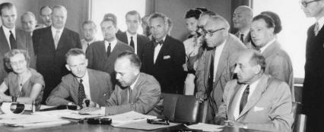
UNHCR’s mandate
“The United Nations High Commissioner for Refugees … shall assume the function of
providing international protection … to refugees … and of
seeking permanent solutions for the problem of refugees …”
UNHCR Statute (1950), para 1
‘The High Commissioner shall provide for the protection of refugees by:
promoting the conclusion and ratification of international conventions for the protection of refugees, supervising their application and proposing amendments thereto… (para 8)

Slide 3
1951
UNHCR a subsidiary organ of the UN;
established as of 1 January 1951 by a resolution of the UN General Assembly
UNGA Res 319A(IV) 3 December 1949; followed by UNGA Res 428(V) of 14 December 1950)

Slide 4
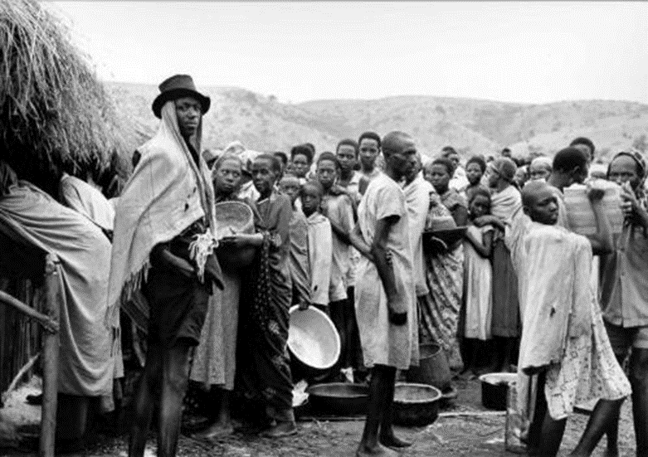
1951
UNHCR was originally established by the General Assembly of the United Nations for a three-year period from 1951 to 1953

Slide 5
History Refworld
Objective: provide access to relevant and high quality info with the overall aim of improving the quality of asylum decisions globally
Audience: asylum-decision makers (UNHCR staff, judiciary, lawyers, legal aid providers, policy and decision makers, scholars)
Maintained by: Refugee Status Determination (content publication) & Digital Engagement Section (technical support)
1990s: COI database (CD /DVD)
2013: interface updated
2019: COI referral
2007: website launch
2018: new strategy
2022/2023: revamped Refworld

Slide 6
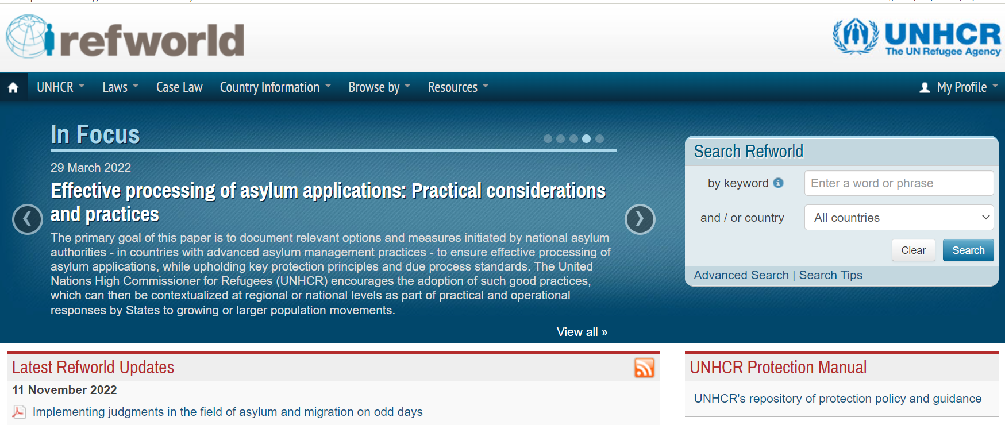

Slide 7
Advanced search

Slide 8
Search tips in Refworld

Slide 9
General info (2021)
CONTENT
Total no of docs: 400,000 (EN + ES + RUS)
Refworld (English):
Legal (35,000), including
national legislation (4,000)
case law (13,000)
Policy (4,000)
Reference (7,000)
COI (215,000)
AUDIENCE
Users: 5.5 million
Page views: 10.5 million
Most viewed sections:
Case law (100,000) & UNHCR publications

Slide 10
Strategy
Phase 1 (2022): migration to new content management system -> to launch revamped Refworld
-> selection and mapping of content & new design
Phase 2 (2023): refinement of Refworld infrastructure and content -> to full-fledged database
-> elaboration of document collections & finetuning of functionalities
Phase 3 (as of 2024): continuous development on annual basis

Slide 11
Mission & Audience
Mission: to be the leading global law and policy database on refugee law, statelessness and internal displacement, providing free, easy and speedy access to comprehensive and high-quality content from UNHCR and authoritative external sources.
Audience:
Judges; lawyers; legal aid workers;
policy and lawmakers;
UNHCR staff;
academics and researchers;
and the general public.
Languages:
Website: English, Russian, Spanish (potentially French in second half of 2023)
Documents: various

Slide 12
Feedback & collaboration
Launch ‘basic’ Refworld: Q1 2023
Feedback: Q2 2023
Enlargement of collections & improvements usability: Q3 & Q4 2023

Slide 13
Online COI training https://www.disasterready.org/

Slide 14
Asante! Thank you! Merci!

